Slide 1

Linux Character Device Driver
niat_zhy@163.com

Slide 2

主要内容
字符设备
数据结构
典型的字符设备
操作接口
高级接口
访问控制
休眠与唤醒

Slide 3
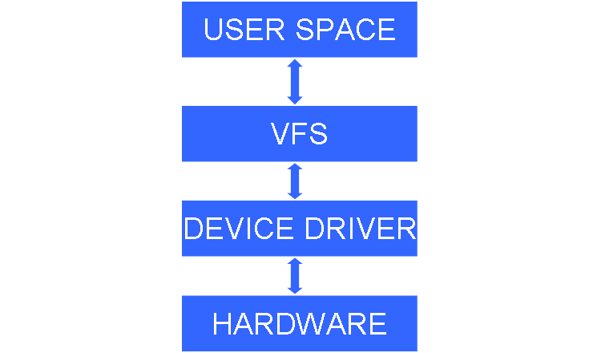
字符设备
设备号
  主设备号
  次设备号
  mknod
  /proc/device
  MAJOR(dev)
  MINOR(dev)
  MKDEV(ma,mi)

Slide 4
字符设备
分配释放设备号
  int register_chrdev_region(dev_t from, unsigned count, const char *name)
  void unregister_chrdev_region(dev_t from, unsigned count)
  int register_chrdev(unsigned int major, const char *name, const struct file_operations *fops)
  int unregister_chrdev(unsigned int major, const char *name)

Slide 5
字符设备
动态分配设备号
  int register_chrdev_region(dev_t from, unsigned count, const char *name)
其它接口
  void cdev_init(struct cdev *cdev, const struct file_operations *fops)
  int cdev_add(struct cdev *p, dev_t dev, unsigned count)
  void cdev_del(struct cdev *p)

Slide 6
数据结构
file_operations
  定义:<linux/fs.h>
  重要元素
    llseek
    read
    write
    ioctl
    poll
    mmap
    open
    flush
    release
    fsync
    …………

Slide 7
数据结构
file
  定义:<linux/fs.h>
  重要元素：
    * f_op
    f_mode
    f_pos
    f_flags O_NONBLOCK
    private_data

Slide 8
数据结构
inode
  定义 :<linux/fs.h>
  重要元素
    i_rdev：设备文件inode结构，包含真正的设备号
    i_cdev：字符设备的内部结构
    i_fop：字符设备公共file_operations def_chr_fops

Slide 9
典型的字符设备
<linux/major.h>
  TTY
  MISC
    int misc_register(struct miscdevice * misc)
    int misc_deregister(struct miscdevice * misc)
  MEM

Slide 10
典型的字符设备
misc demos
  static struct file_operations rtc_fops = {
  .ioctl = rtc_ioctl,
  };
  static struct miscdevice rtc_dev = {
  .minor = RTC_MINOR,
  .name = "rtc",
  .fops = &rtc_fops,
  };
  misc_register(&rtc_dev);

Slide 11
操作接口
open/release
  int (*open) (struct inode *, struct file *)
    检测设备特定错误
    是否需要初始化
    是否需要更新f_op；
    根据需要初始化filep-> private_data
  int (*release) (struct inode *, struct file *)
    释放由open分配的、及保存在filep-> private_data中的所有内容
    最后一次关闭操作时关闭设备

Slide 12
操作接口
read/write
  copy_to_user()
  copy_from_user()
  ssize_t (*read) (struct file *, char __user *, size_t, loff_t *)
  ssize_t (*write) (struct file *, const char __user *, size_t, loff_t *)

Slide 13
高级接口
ioctl
  int (*ioctl) (struct inode *, struct file *, unsigned int, unsigned long)

Slide 14
高级接口
poll/select
  unsigned int (*poll) (struct file *, struct poll_table_struct *)

Slide 15
高级接口
llseck
  loff_t (*llseek) (struct file *, loff_t, int)
  SEEK_SET、SEEK_CUR、SEEK_END

Slide 16
llseek demos
  loff_t scull_llseek(struct file *filp, loff_t off, int whence)
  {
  struct scull_dev *dev = filp->private_data;
  switch(whence) {
  case 0: /* SEEK_SET */
  filp->f_pos = off;
  break;
  case 1: /* SEEK_CUR */
  filp->f_pos = filp->f_pos + off;
  break;
  case 2: /* SEEK_END */
  filp->f_pos = dev->size;
  break;
  default:
  return –EINVAL;
  }
  return filp->f_pos;
  }

Slide 17
访问控制
独享设备
  原子操作
    atomic_t is_opened;
限制访问数量
  原子计数器

Slide 18
休眠与唤醒
简单休眠与唤醒
  wait_event(wq, condition)
  wait_event_timeout(wq, condition, timeout)
  wait_event_interruptible(wq, condition)
  wait_event_interruptible_timeout(wq, condition, timeout)
  wake_up(wait_queue_head_t *wq)
  wake_up_interruptible(wait_queue_head_t *wq)

Slide 19
休眠与唤醒
高级休眠
  schedule()

